Slide 1
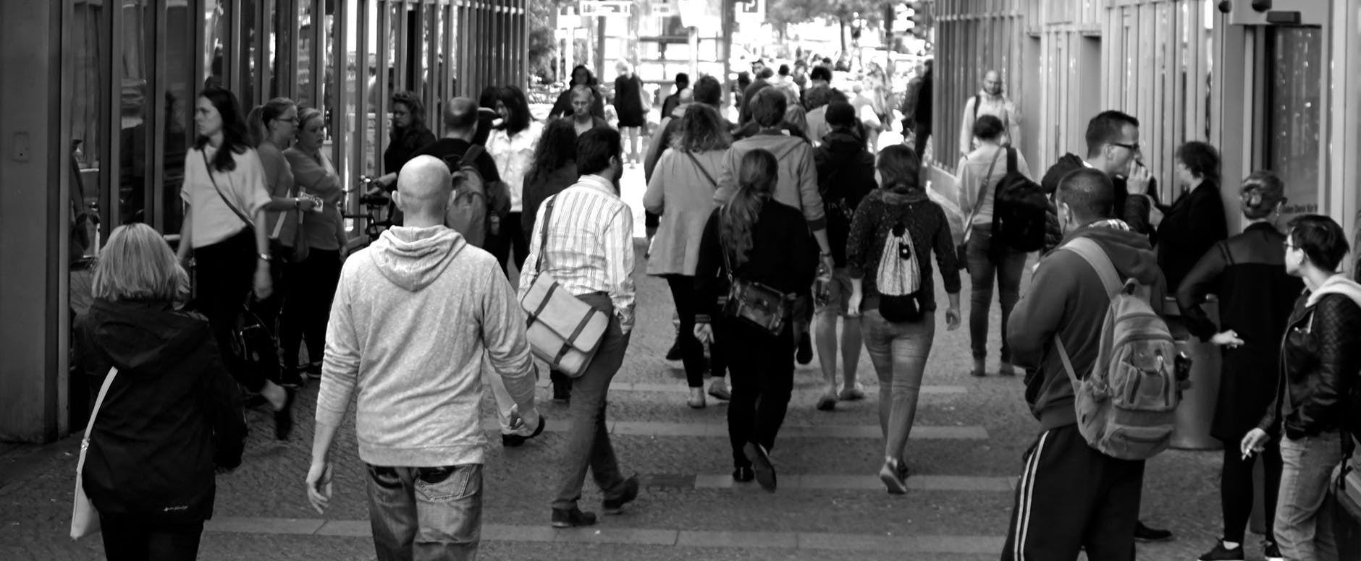
TRENDS IN URBAN FLOWS
Wi-Fi requests as a data source

Slide 2

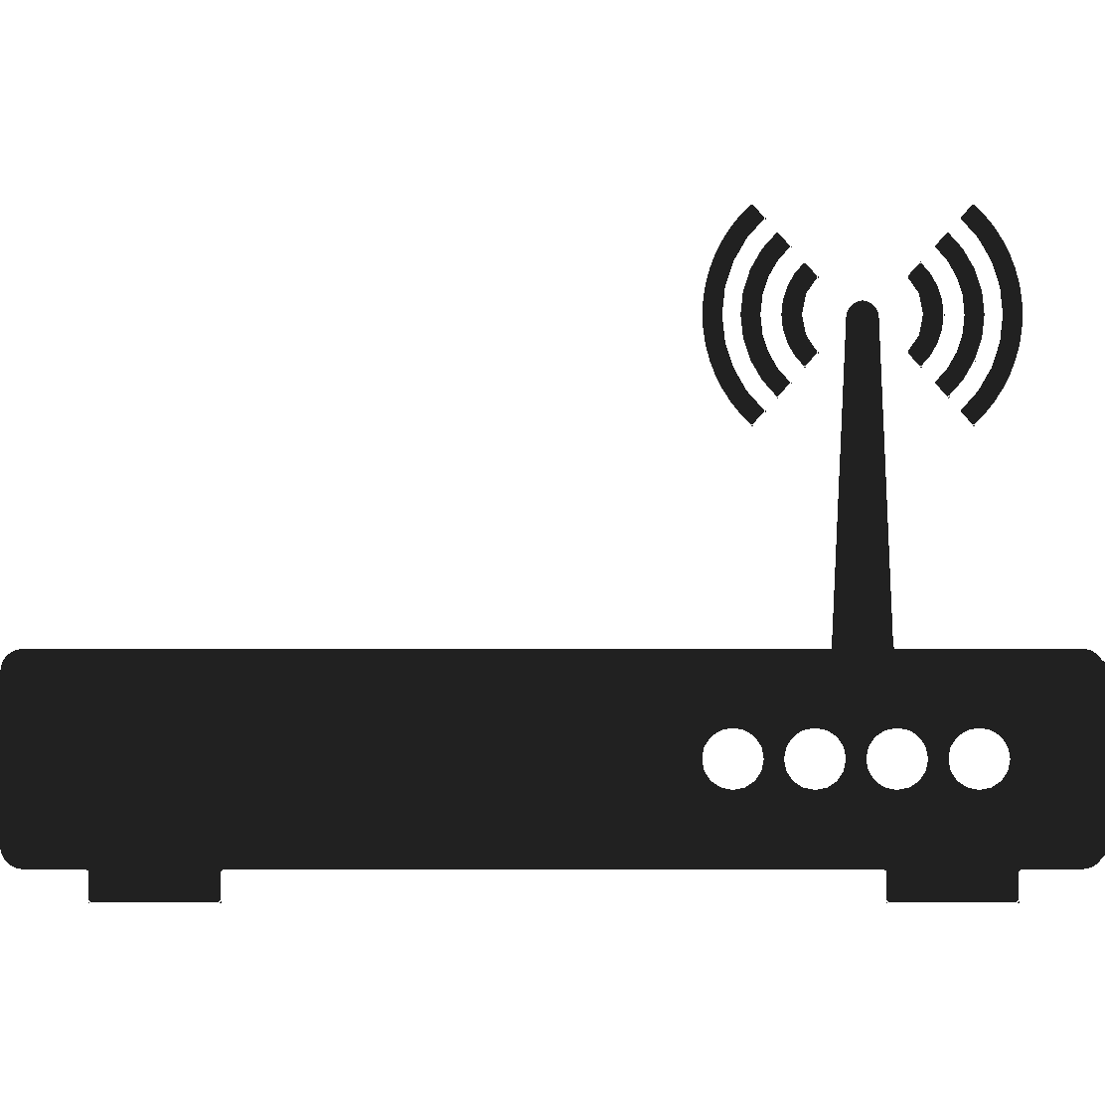
Almost everyone carries a Wi-Fi enabled device
90%
Almost everyone is broadcasting their presence all the time through Wi-Fi probe requests

Slide 3


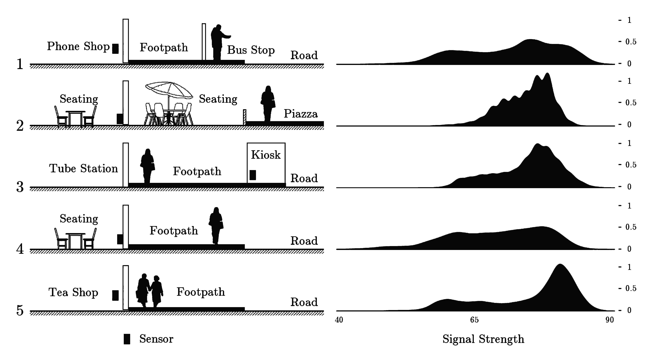

SmartStreetSensor Project
1000+ locations across Great Britain (~35 % of them in the Greater London area).
During 2017 – 2018 we analysed ~110 million records corresponding to all the aggregated 5-minutes FF counts
Sensor

Slide 4


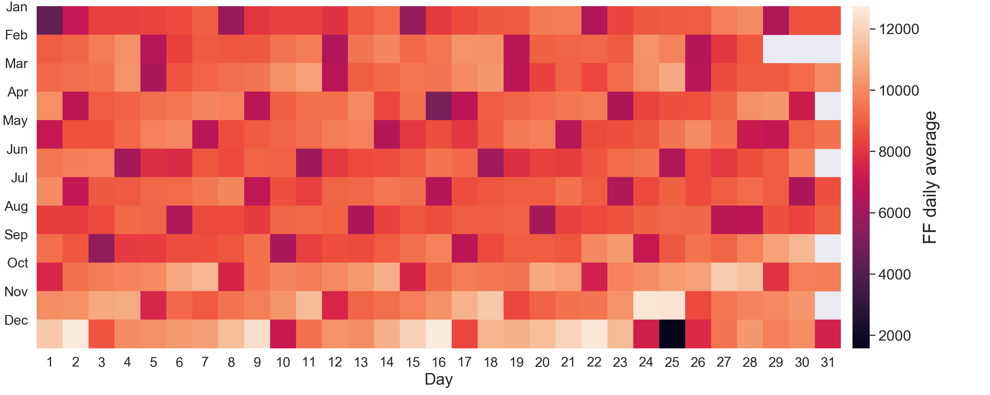
From probe request to FF counts

Slide 5
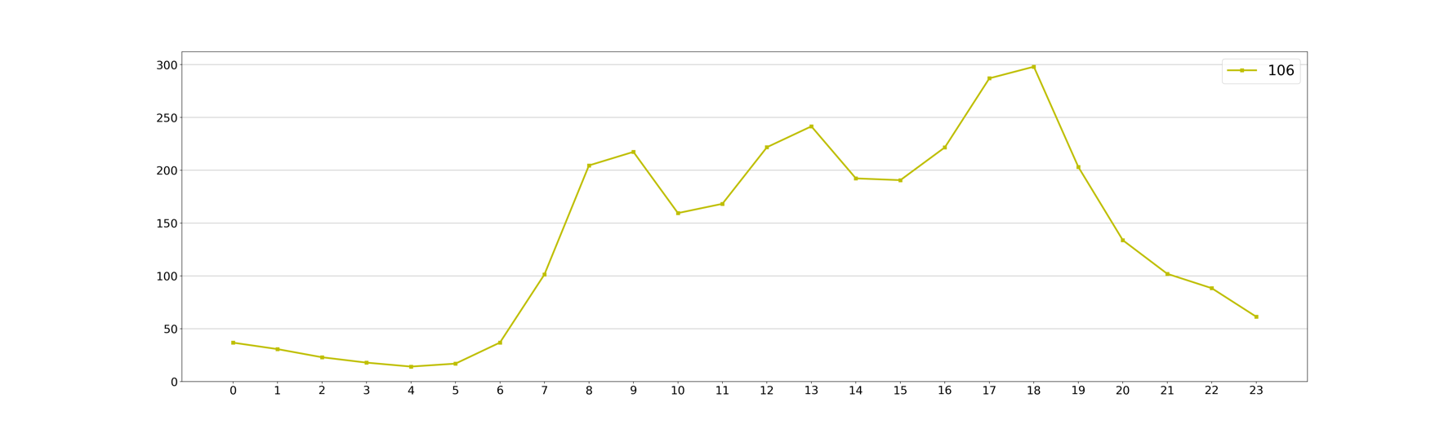
Validation
External sources like
Similar studies
Extraordinary events
Transport data (Taps IN/OUT London Underground)
Google popular times
Tottenham court Road station counts Weekday average 2017/2018
Sensor at the corner of Oxford St and Tottenham Court Rd

Slide 6
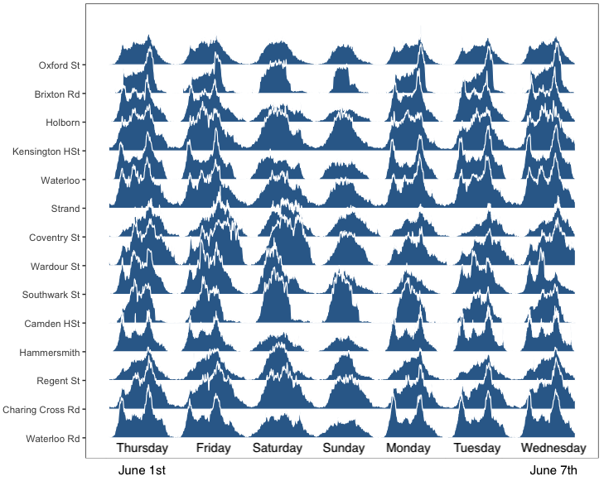
Results 1
FF Signal
Each location has a
particular behaviour
or signal

Slide 7
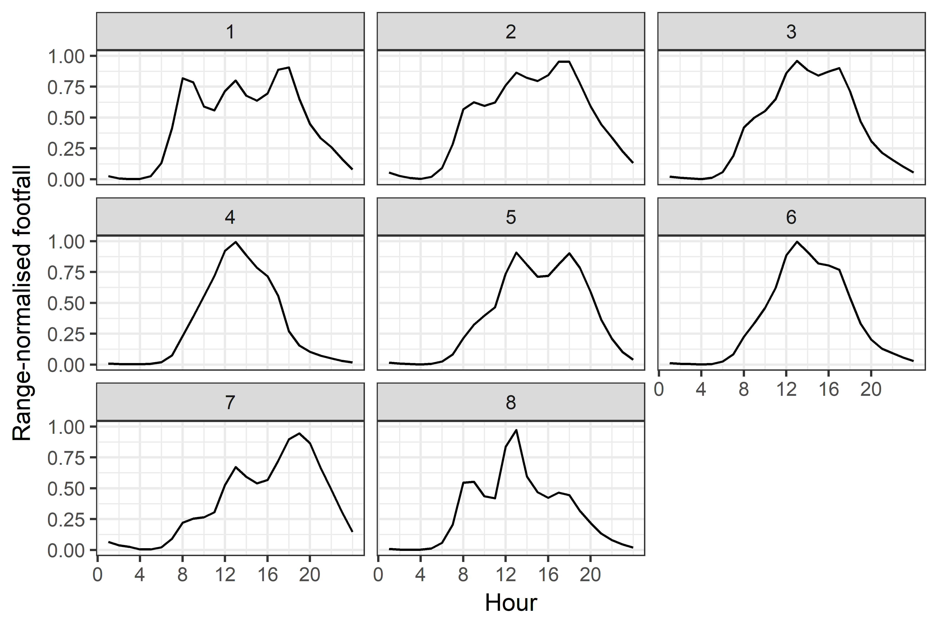
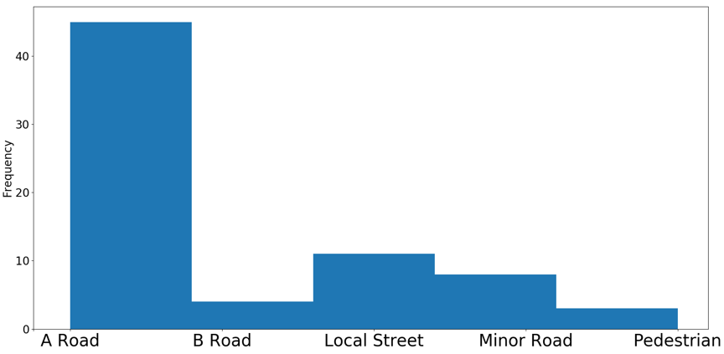
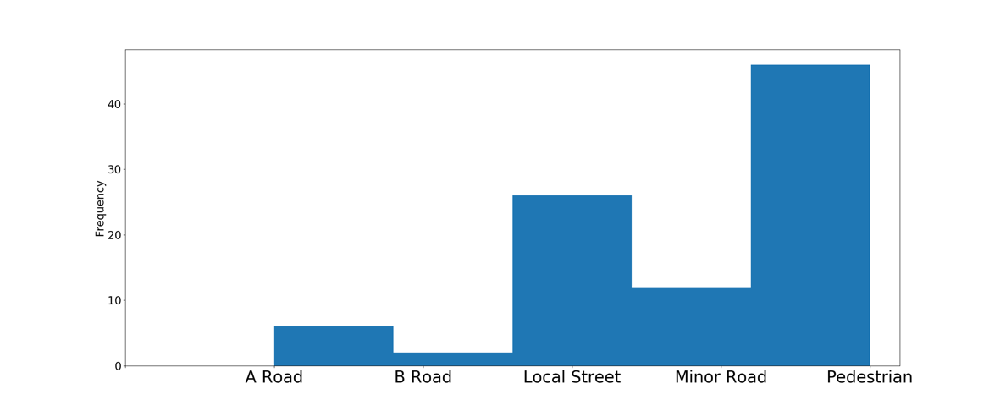
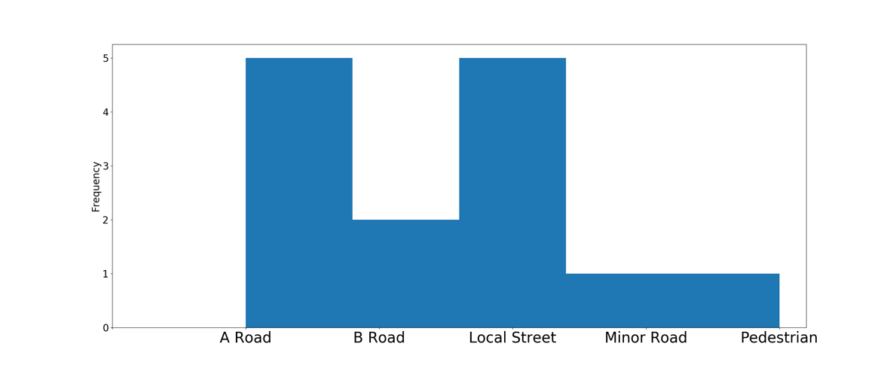
Results 2
2. Great Britain’s FF signal classification

Slide 8
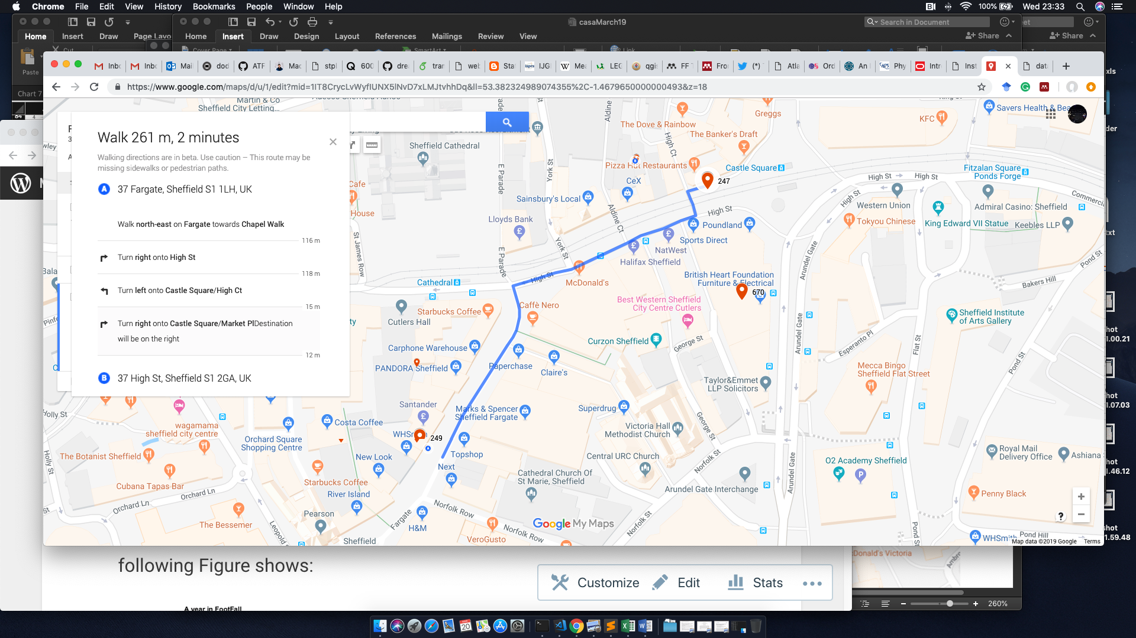
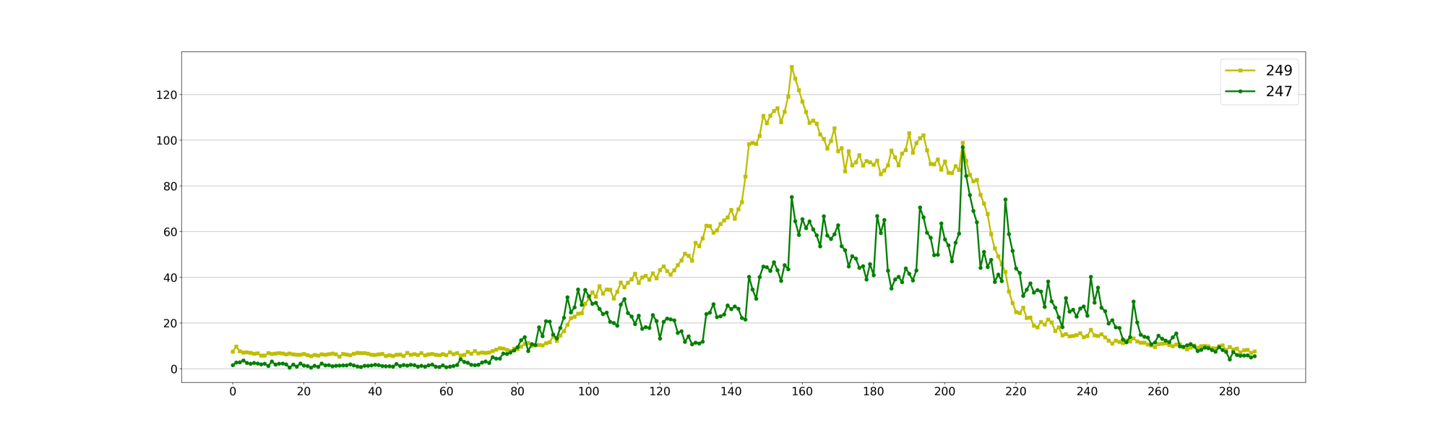
Results 3- Urban flows (or coupling locations)

Slide 9
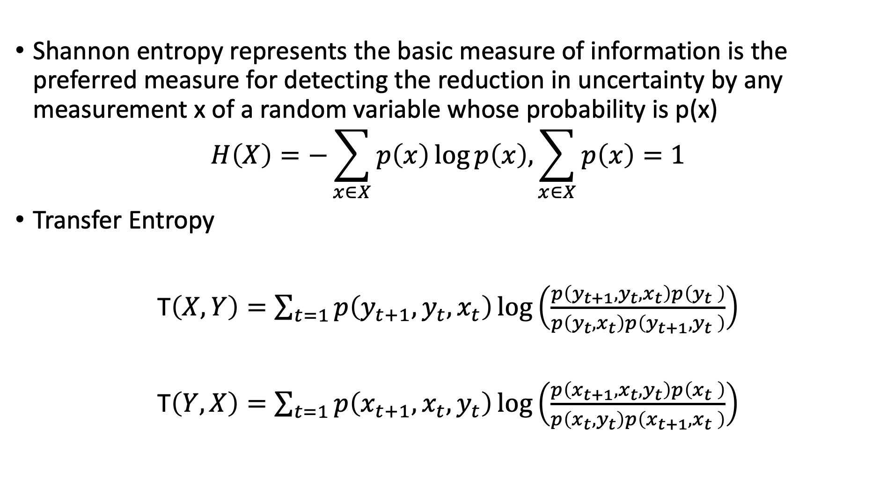
Information measures
Shannon entropy represents the basic measure of information is the preferred measure for detecting the reduction in uncertainty by any measurement x of a random variable whose probability is p(x)
$$H\left(X\right)=−\sum_{x∈X}{p\left(x\right)\log{p\left(x\right),\sum_{x∈X}{p\left(x\right)=1} }}$$
Transfer Entropy
T$\left(X,Y\right)=\sum_{t=1}{p\left(y_{t+1},y_{t},x_{t}\right)\log\left(\frac{p\left(y_{t+1},y_{t},x_{t}\right)p\left(y_{t} \right)}{p\left(y_{t},x_{t}\right)p\left(y_{t+1},y_{t} \right)}\right) }$
T$\left(Y,X\right)=\sum_{t=1}{p\left(x_{t+1},x_{t},y_{t}\right)\log\left(\frac{p\left(x_{t+1},x_{t},y_{t}\right)p\left(x_{t} \right)}{p\left(x_{t},y_{t}\right)p\left(x_{t+1},x_{t} \right)}\right) }$

Slide 10
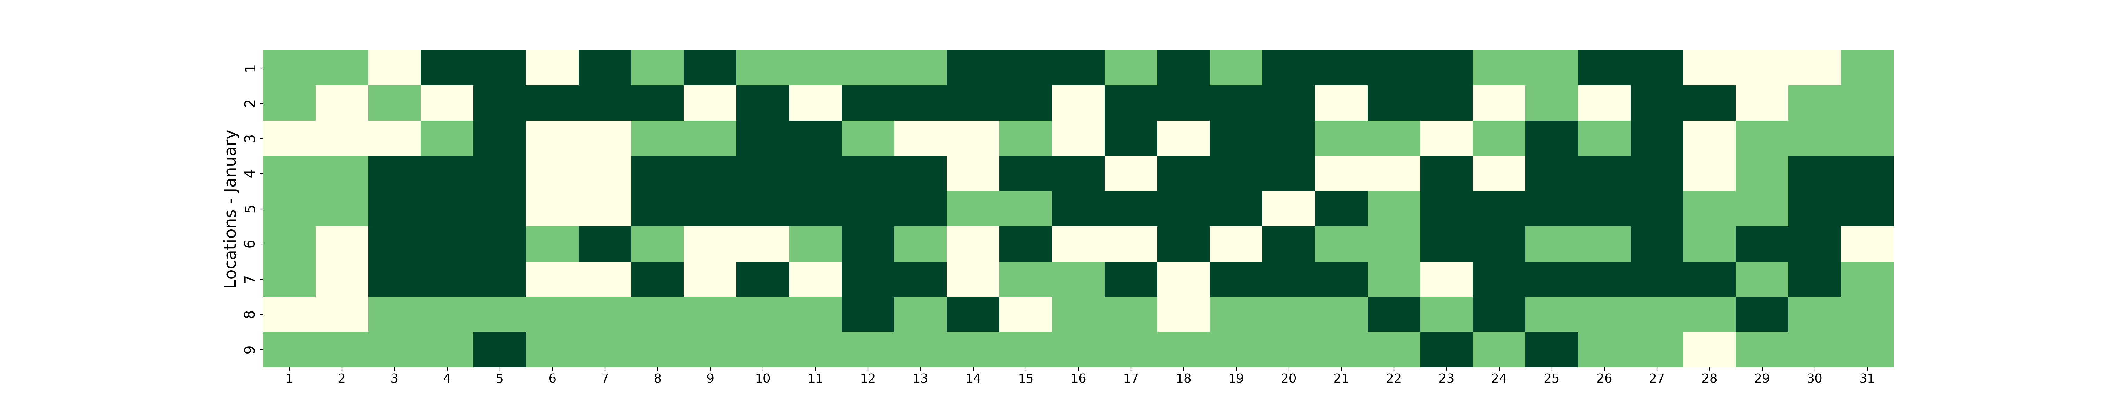
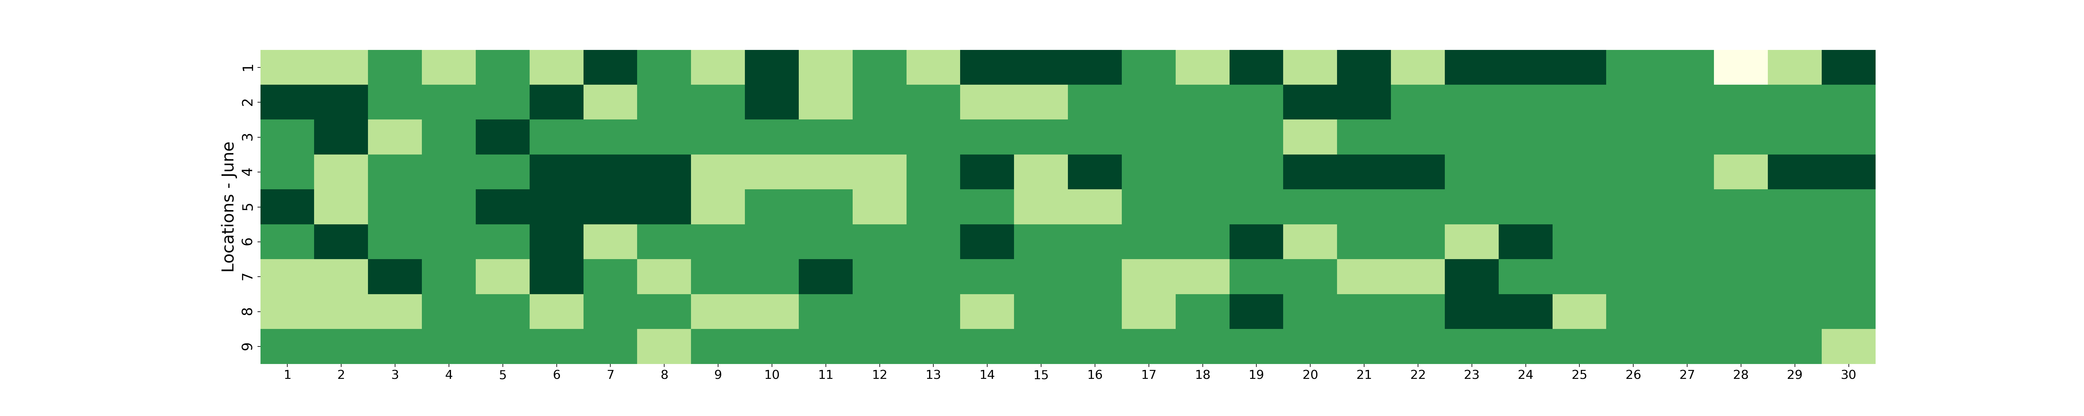
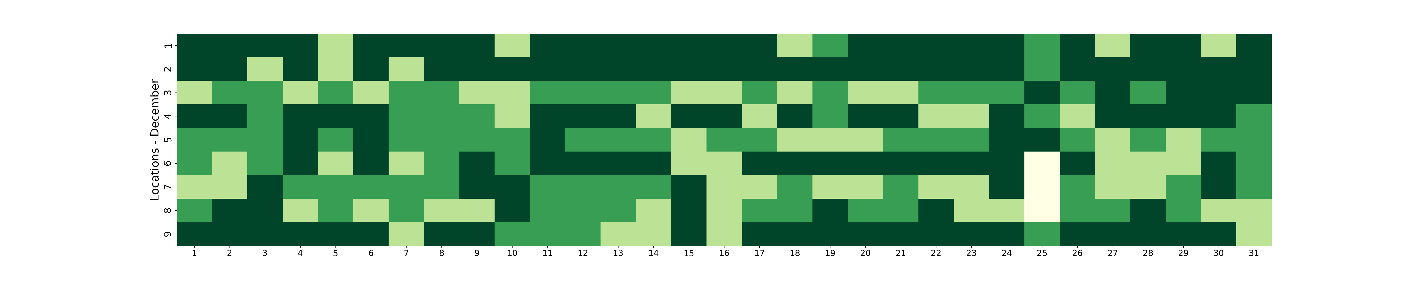

Slide 11
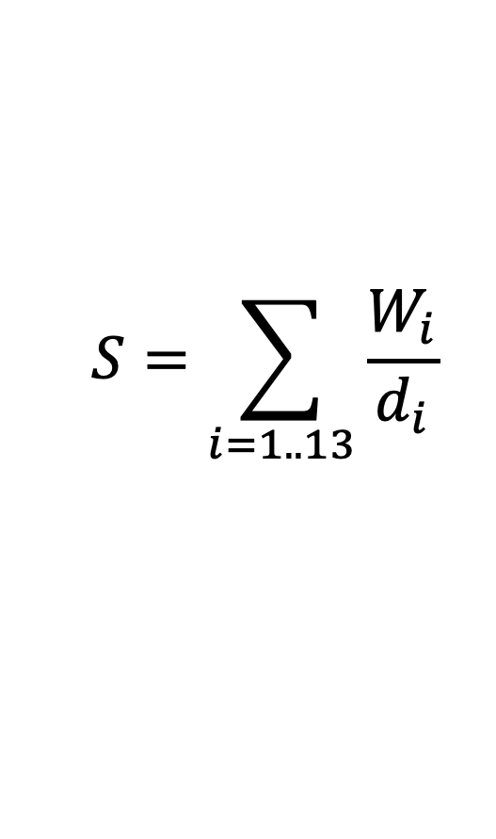
Route complexity
From the google journey planner API
Direction | Value | Context
head, toward(s), continue, follow, straight, walk | 1 | ”Head<direction> toward<place>”
slight, sharp | 2 | ”Slight right onto<place>”
turn | 3 | ”Turn<left, right> onto<place>”
Cross | 4 | ”Cross<street> at <place>”
upper, take | 5 | ”Take the stairs”
roundabout | 6 | ”At the roundabout, take exit onto<place>”
$$S=\sum_{i=1..13}{\frac{W_{i}}{d_{i}}}$$

Slide 12
Conclusions
Can we use probe requests as a proxy to detect human activity? YES
Can we use FF signals to classify areas? YES
The relation between two signals is NOT a function of the walking distance between them.
We can have a feeling about the flow of people between two locations using LTE

